Slide 1
Representing Data as Sequences

Slide 2
Limitation of itemsets
Itemset representation ignores order and quantity
Vector representation handles quantity . . .
but what about order?

Slide 3
Example: Course Recommender System
Pattern: Many people who have taken “data mining” have also taken “python programming.”
Recommender: You have taken “data mining,” so it is recommended you take “python programming” next.
Does this recommendation make sense?

Slide 4

Order matters in reality...
Viewed this model of laptop on dell.com as shown in this Facebook ad.
Ended up purchasing a different model.
Having already purchased another model, is this ad relevant anymore?

Slide 5
From itemset to sequence
Complex Data object: a curriculum path, a DNA sequence, a session of search queries, a sentence (of words), a sequence of user actions
Introduction to Python
Python for Data Science
Data Mining I
Data Mining II
Categorical items
organized in a sequential order

Slide 6


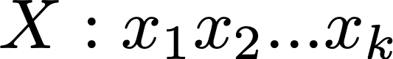
The Sequence Representation
x_{k} is the categorical item that appears at the k^{th} position of X.

Slide 7
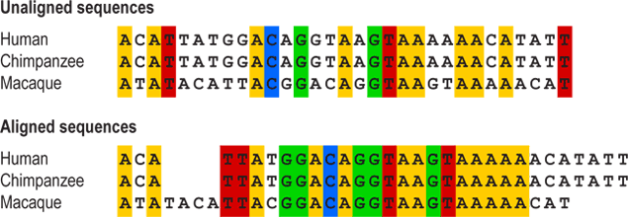
Example of Biological Sequences
Base Items: A, T, C, G
Only order matters; absolute position does not matter.
Image source: University of California Museum of Paleontology - https://evolution.berkeley.edu/evolibrary/article/0_0_0/evotrees_build_04

Slide 8
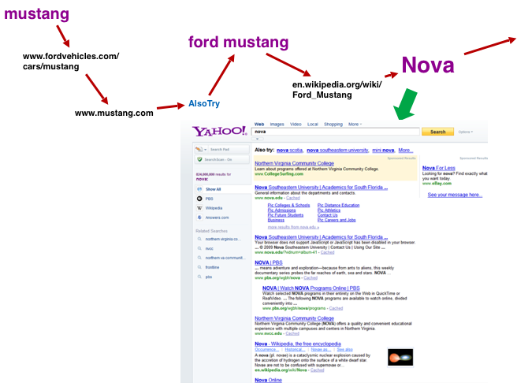
Example of Behavioral Sequences
Items: queries, URLs, clickthroughs
Only order of actions matter; time does not matter.

Slide 9


School of Information, University of Michigan
Qiaozhu Mei
School of Information
All Content © Presenter

